Slide 1
Final case walkthrough and legal compliance

Slide 2
Case Overview
Incident: Suspicious activity discovered on workstation
Date of Investigation: 12 December 2015
Key Discovery: A taunting message left on the system (“Catch me if you can!”)
Primary Goal: Determine what happened, identify attacker activity, evaluate forensic soundness

Slide 3
Attack Summary (What Actually Happened)
Attacker created a new local user “master”
Dropped multiple taunting text files
Modified/replaced magnify.exe (Accessibility tool)
Planted persistence LNK files in master and administrator user profiles
Executed magnify.exe (confirmed via Prefetch & Amcache)
Connected externally immediately after execution
Performed anti-forensics using:
  System time rollback
  Deleting Windows Event Logs (confirmed missing)
  $I30 index wiping
Attempted to create misleading timestamps
This was a coordinated attack with intent to hide activity.

Slide 4
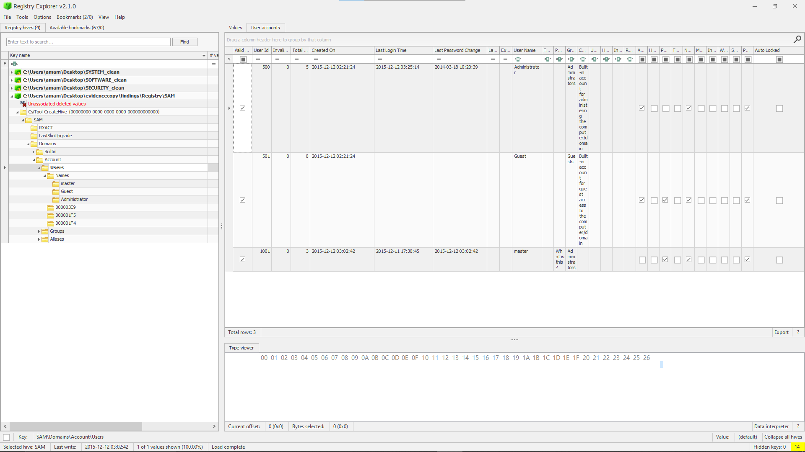
Accounts on the system

Slide 5
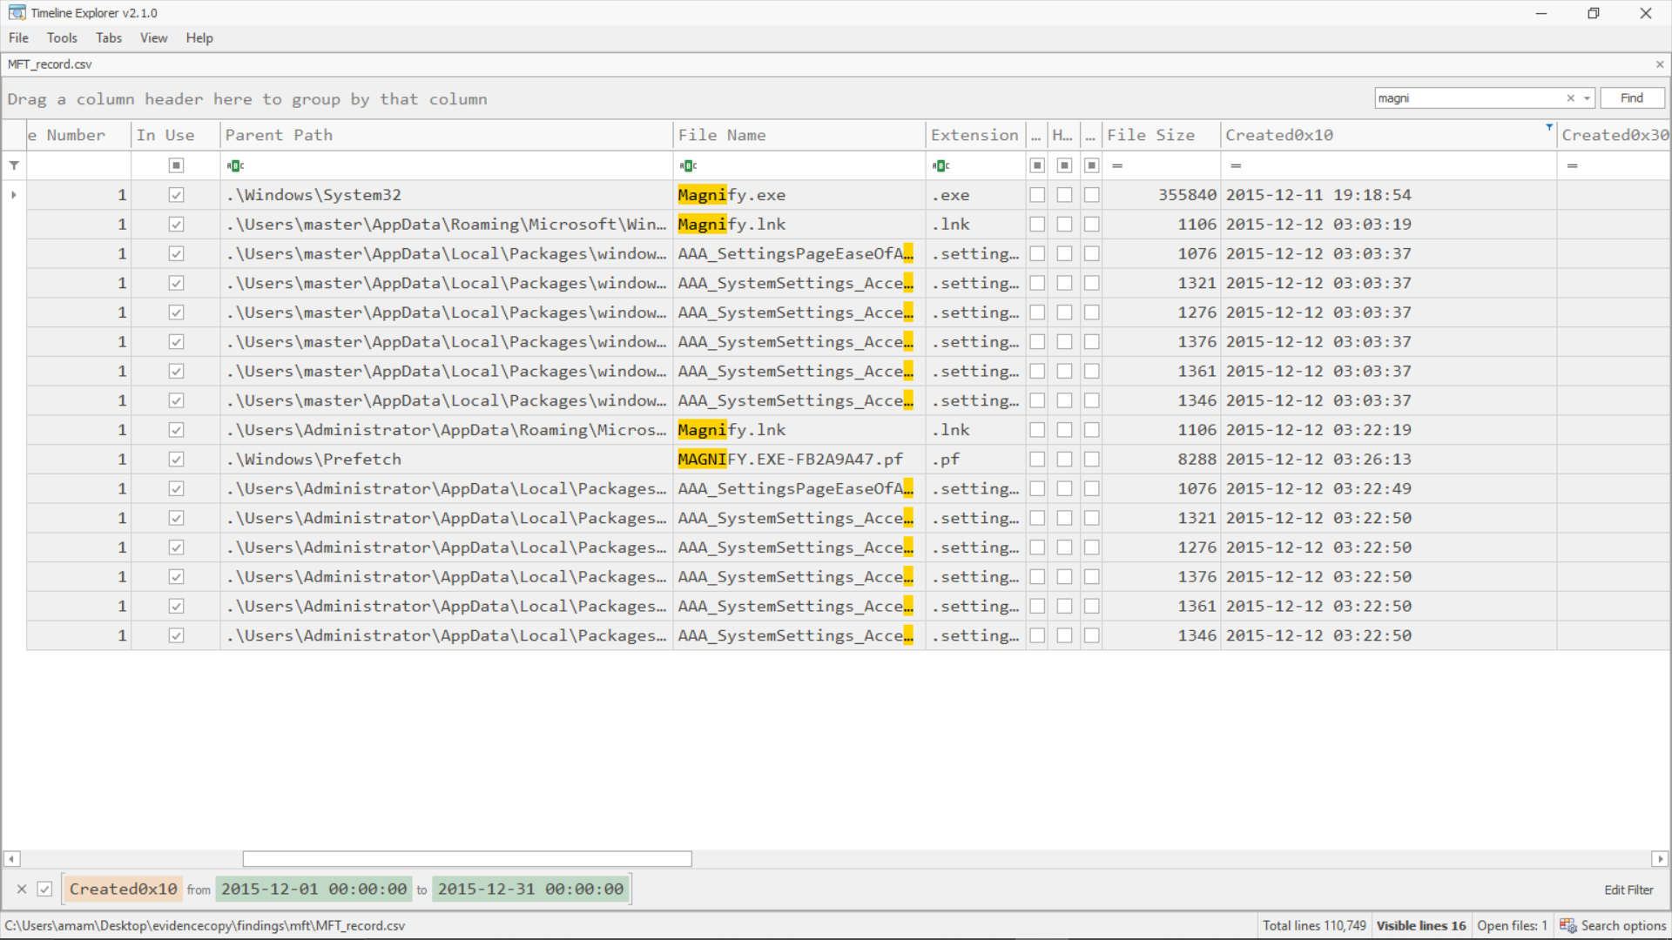
magnify.exe

Slide 6
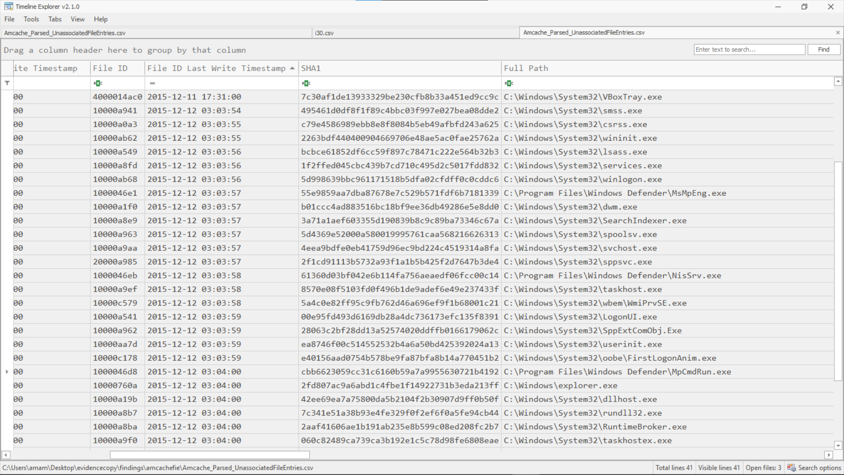
System logon event (“FirstLogonAnim.exe”)

Slide 7
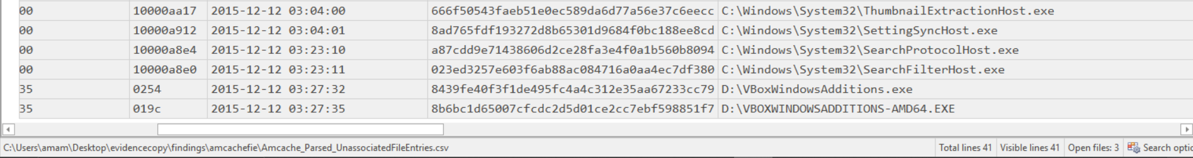
ThumbnailExtractionHost.exe executed

Slide 8
info.txt created

Slide 9
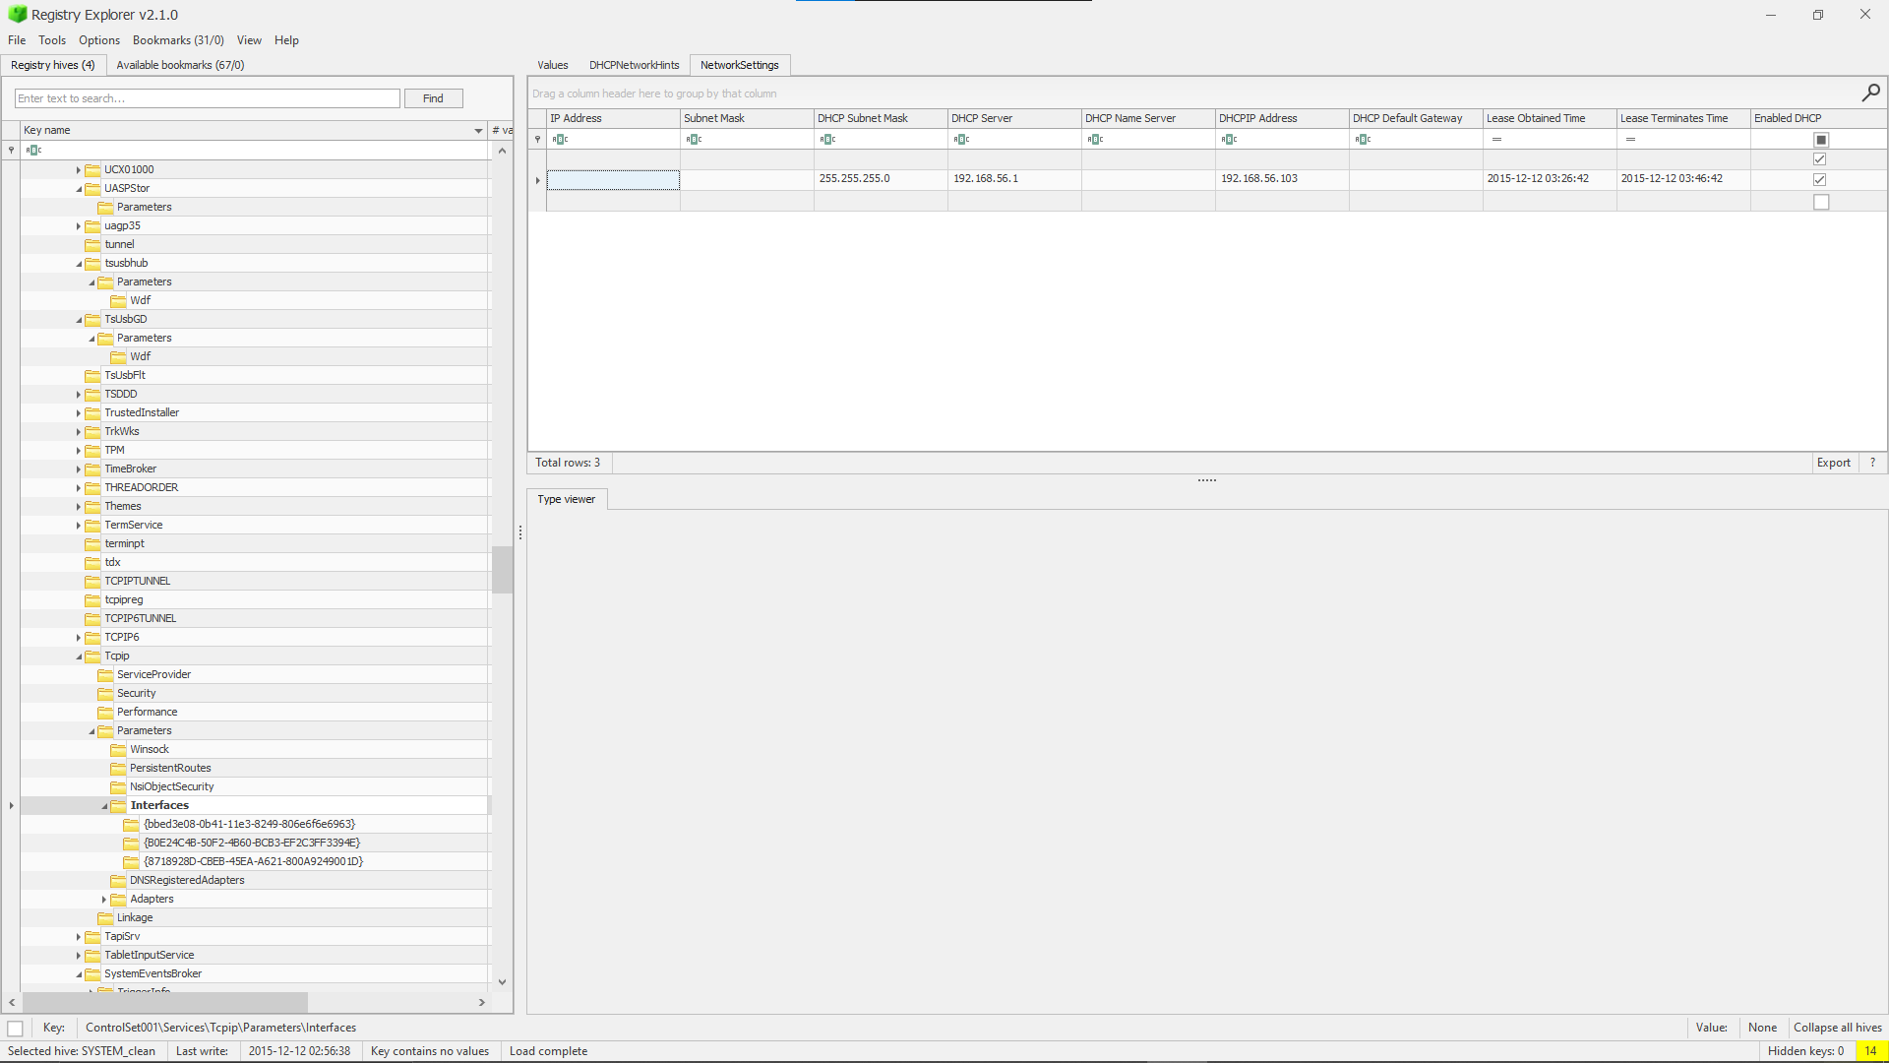
Suspicious network connection in Tcpip Interfaces

Slide 10
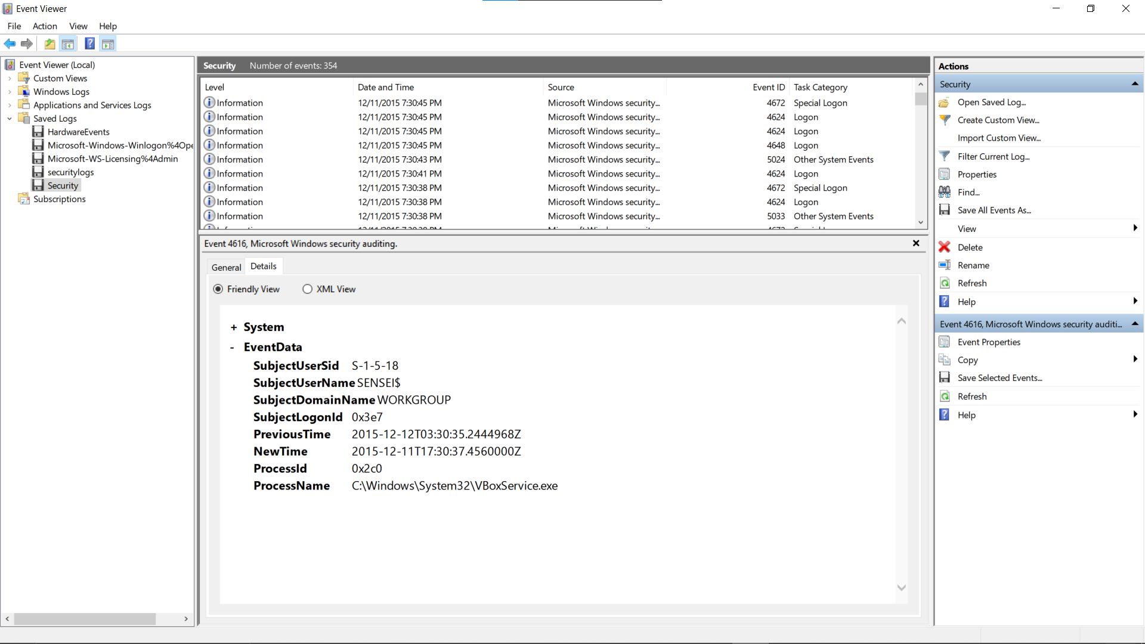
SYSTEM TIME CHANGED

Slide 11
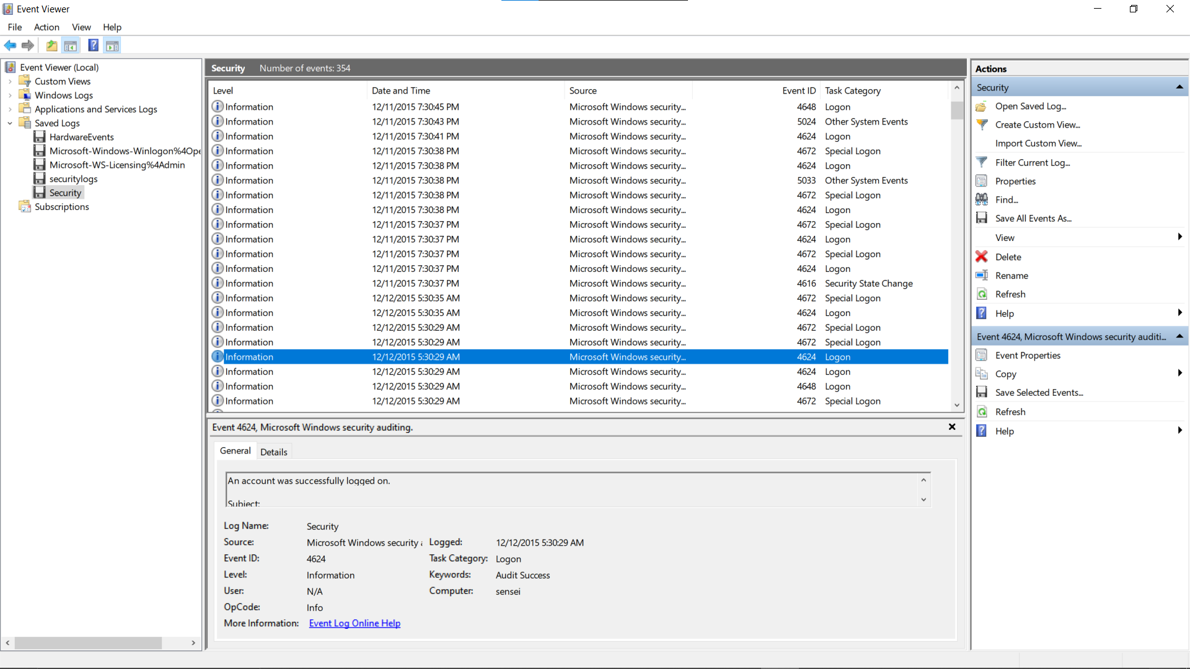
master login

Slide 12
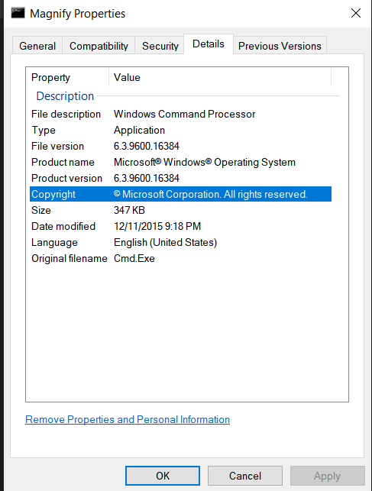
magnify.exe

Slide 13
Legal Compliance: Evidence Handling
Hashing
  Disk acquired with FTK Imager
  SHA-1 & MD5 hashes recorded for each evidence source
Ensures forensic soundness
  Supports evidence admissibility
Chain of Custody
  Recorded each step:
    Disk acquisition
    Exported registry hives
    Extraction of LNK, MFT, logs
      Ensures no tampering
      Required for courtroom use

Slide 14
Legal Assessment of the Attack
Intent
  Evidence indicates deliberate sabotage & harassment, not accidental behavior.
Unauthorized Access
  Creating “master” account = unauthorized system modification
  Replacing magnify.exe = security breach
  Network connections = possible exfiltration attempt
Tampering with Logs
  Deleting logs constitutes obstruction of investigation.
Timeline Manipulation
  System time rollback = high-level anti-forensics

Slide 15
Final Case Conclusion
Attacker used a newly created account (“master”) to carry out all actions
Persistence established via modified magnify.exe + LNK placement
Messages intentionally left to taunt system owner
Anti-forensics performed via log wiping + time manipulation
Evidence consistently correlates across:
  MFT
  Amcache
  LNK files
  Registry
  Prefetch
  Document timestamps
Final Finding:
This was a deliberate intrusion involving persistence, deception, and forensic evasion.

